Slide 1

Decentralized voting application based on Ethereum blockchain
Jamala Khaligova (A0JCKR)
BSc Computer Science, ELTE
Supervisor: Dr. Szabo Laszlo
Date: 26 January 2022

Slide 2
Thesis Motivation
Transparent voting system
Eliminating centralization by using peer-to-peer network
More secure voting option using blockchain technology
Immutability – no one can modify, insert, delete data in distributed ledger technology
Fast processing time compared to traditional voting systems
Accessible to anyone with an Internet connection

Slide 3
KEY Concepts
DApps (Decentralized Apps) are blockchain based applications.
P2P network – each node can be either client or server, meaning that all nodes can request and send data. All computers in the network are connected, where each stores complete copy of the ledger.
Smart Contracts (Ethereum) carries out transactions and agreements between anonymous parties.
Web3 – Web2
Transactions refers to an action initiated by an externally-owned account, in other words an account managed by a human, not a contract.

Slide 4
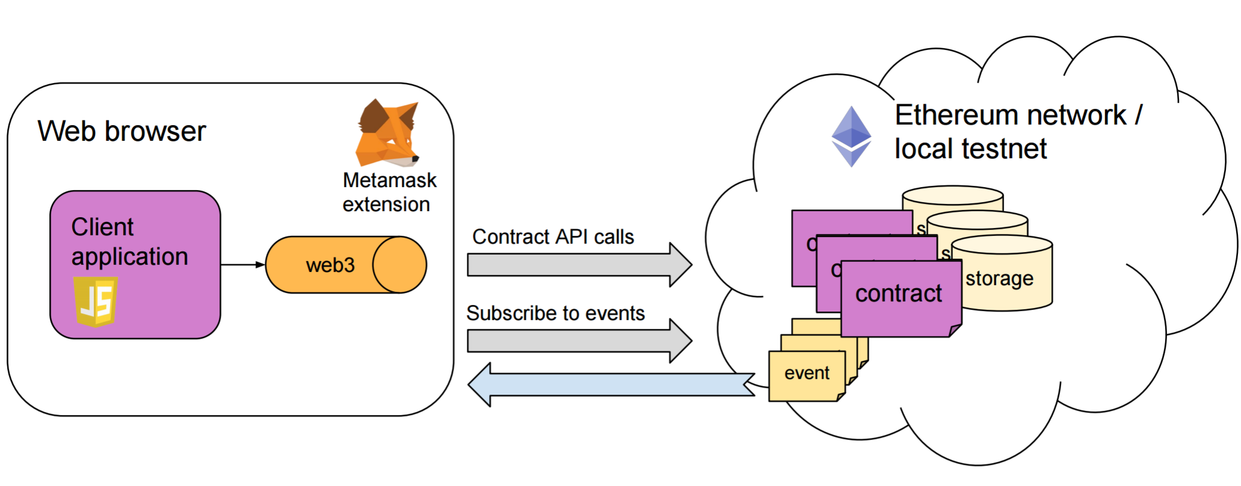
Architecture
In this application, the client is a web application running in the browser. In order to call Ethereum network API, web3.js library and connection to a Ethereum network node is needed.

Slide 5
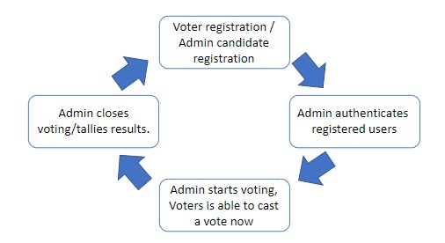
workflow

Slide 6
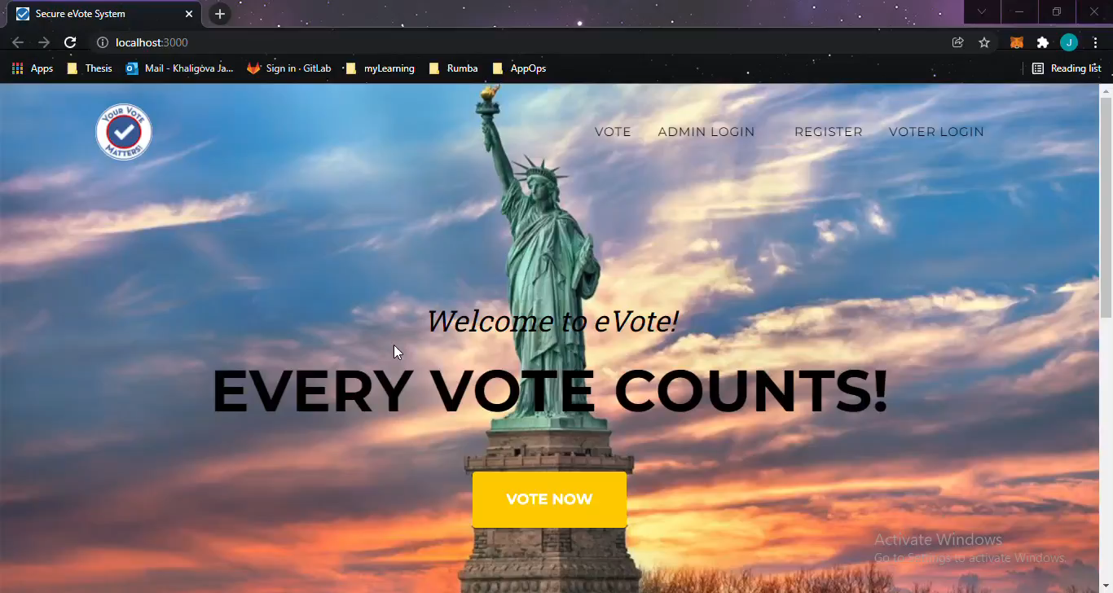
Thesis demo

Slide 7
testing
Frontend was tested manually (checking the functionality of website).
Smart Contract was tested by using Truffle framework. Truffle tests will be unit test, since it only tests if smart contract methods working correctly in various test cases. Truffle uses the Mocha testing framework and Chai assertion library to provide a solid framework for JavaScript test. JavaScript test gives more flexibility and enables to write more complex tests.

Slide 8
Technologies I used
Truffle - compile, deploy and test smart contracts, inject them into web apps
Solidity language - statically-typed programming language designed for developing smart contracts that run on Ethereum.
Metamask – is a browser plugin that acts as a bridge between Ethereum Blockchain and the browser.
Ganache - personalized blockchain for Ethereum development.
Web3 JS library – is the new version of the internet, where services will run on blockchain.
Lite server - a lightweight development server that serves a web application.
Node.js – npm package manager is required to install JavaScript libraries.

Slide 9
Challenges
Novelty of the technologies, it was hard to find tutorials
Run time errors in smart contract – only identifiable after deploying on blockchain
In solidity, there is no built-in function to convert string to address type.

Slide 10

Thank you for your attention

